Slide 1

Amazon Sales Report
Insight of amazon sale from 2010- 2017

Slide 2
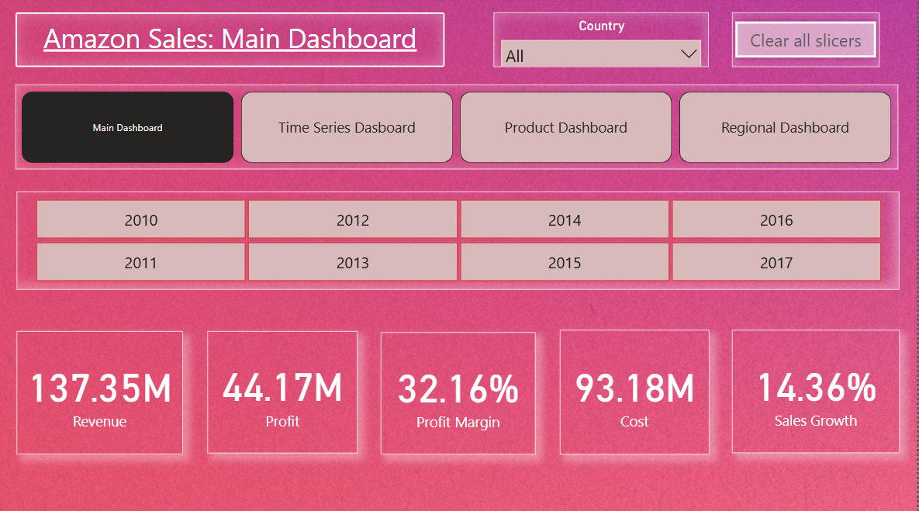
Amazon Sales KPI
This is overall sales KPI from year 2010-2017

Slide 3
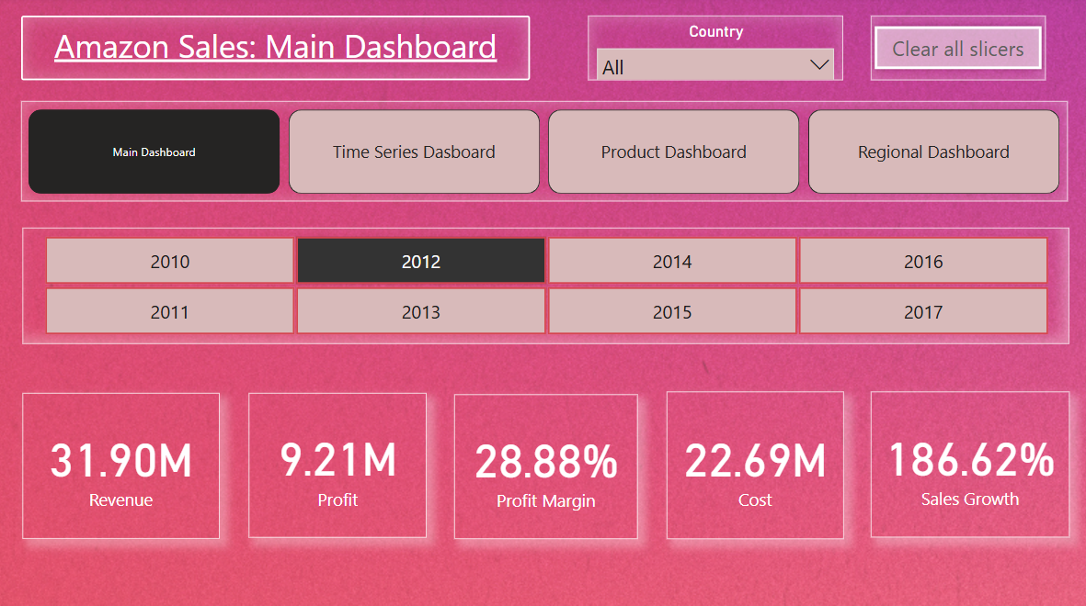
Highest Sale Growth Year is 2012

Slide 4
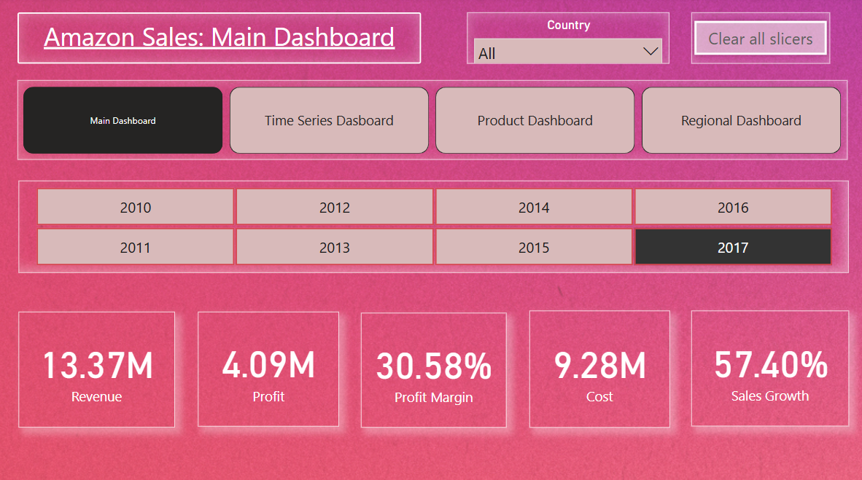
2nd Highest Sale Growth Year is 2017

Slide 5
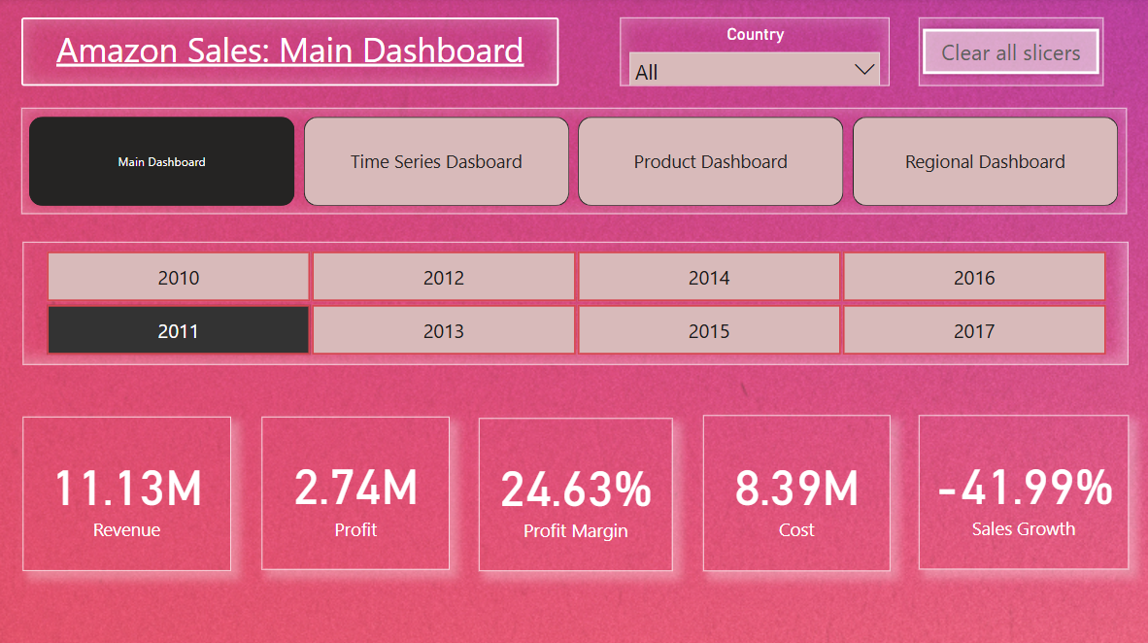
Most least sale Growth

Slide 6
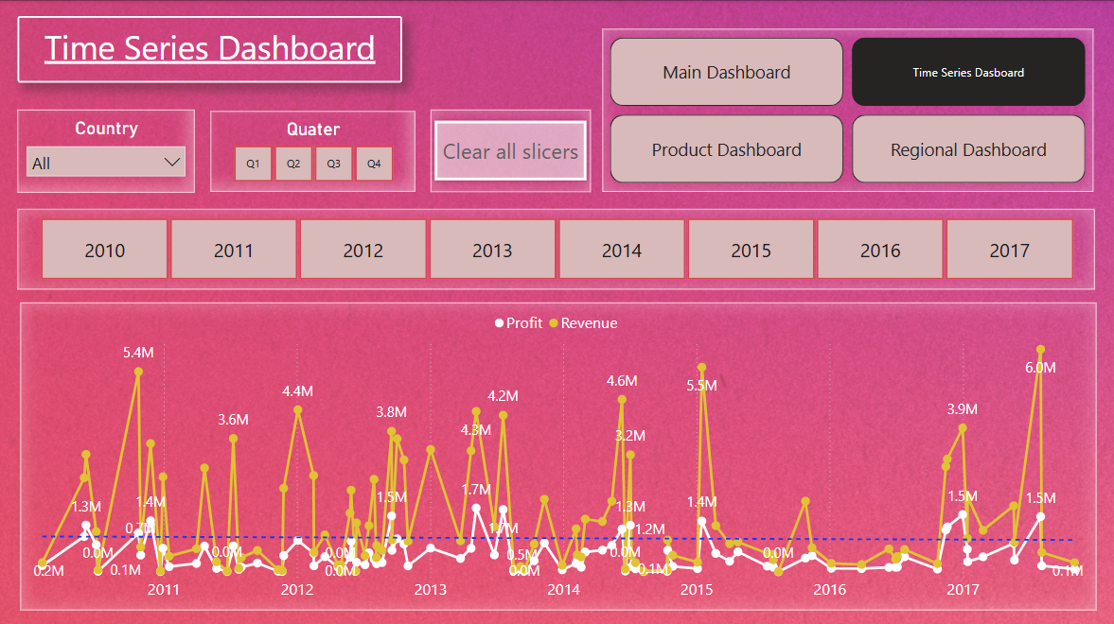
Time Series Analysis
Yearly: Revenue and Profit Trends
We can see overall Revenue and Profit are a Straight trending line.
Trend on whole year in 2010,2011,2012,2015,2016 are almost same.

Slide 7
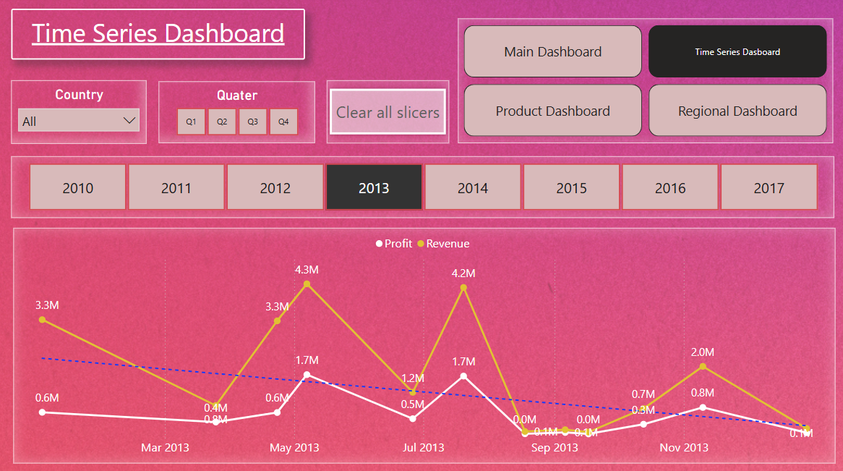
In 2013, Revenue and profit are high at beginning of year but at the end of year both are get low.

Slide 8
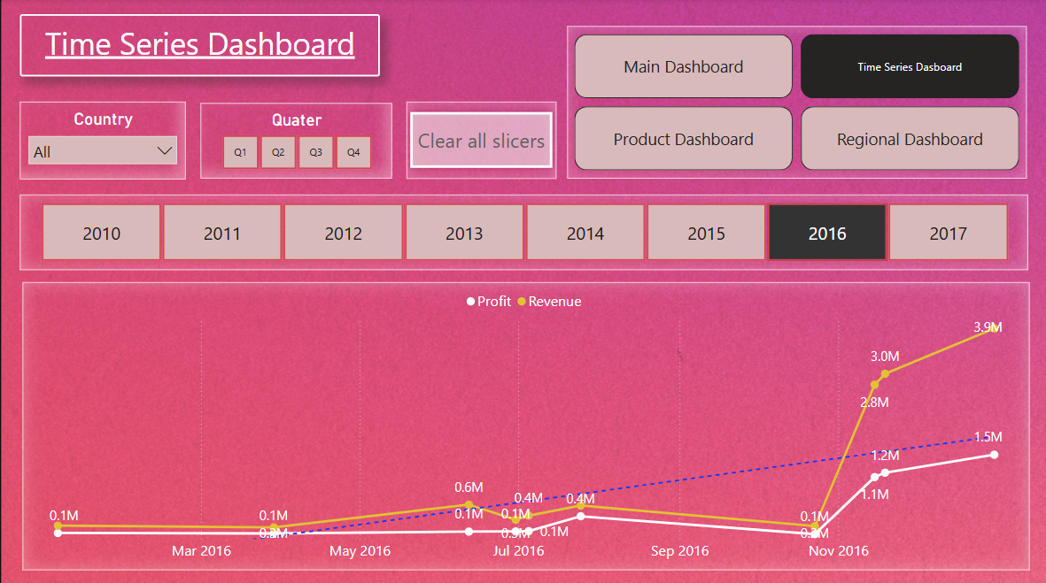
In 2016, Revenue and profit are low at beginning of year but as per trend it went high at the end of year. .

Slide 9
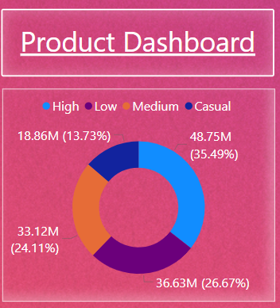
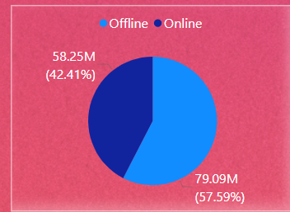
Sale Product Analysis
- As Revenue by Priority As ‘High’ is 35%
- ‘Casual’ is least by Revenue collection.
Both ‘Low’ and ‘Medium’ is same contribution as we can see.
- Online Sale are high as comparison to offline channel.

Slide 10
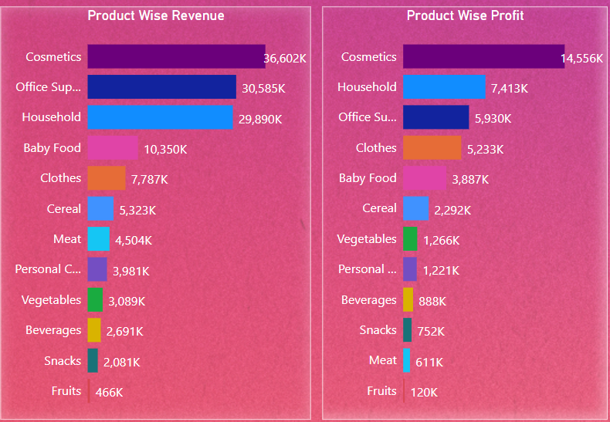
As Revenue and Profit Per Product. - ‘Cosmetics’ at rank 1st on both Sales and Profit product. - ‘Office Supply’ at Rank 2nd at Sales but 3rd at Profit - ‘Household’ at Rank 3rd at sales but 2nd at profit.

Slide 11
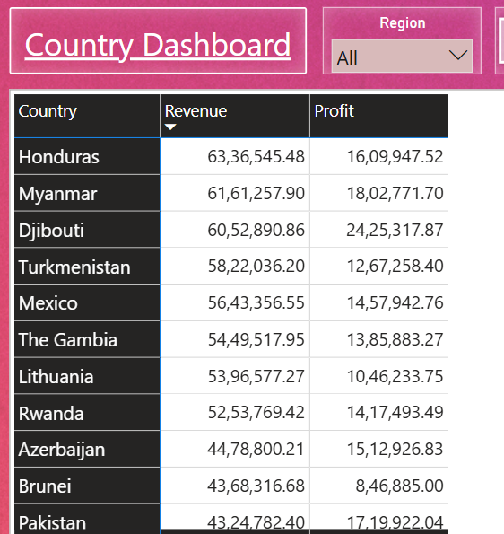
Country Wise Analysis
As Top 7 Sales countries are Hondruas, Myanmar, Djibouti, Turkmenistan, Mexico, The Gambia, Lithuania

Slide 12
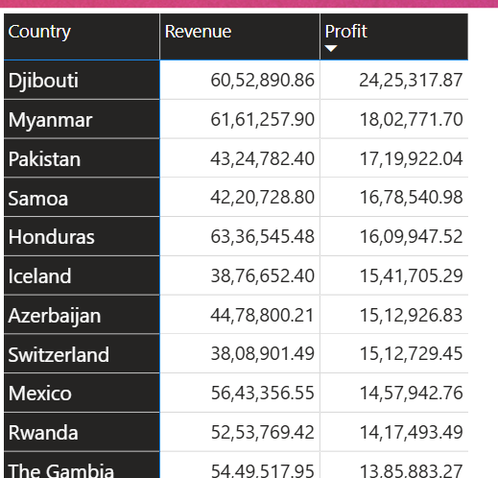
As Top 7 Profitable countries are Djibouti, Myanmar, Pakistan, Samoa, Honduras, Iceland, Azerbaizan.

Slide 13
THANK YOU

